Slide 1
Control Flow Testing
Lecture 9
Madiha Malik

Slide 2
int main()
{
int n, i;
float num[100], sum=0.0, average;
cout << "Enter the numbers of data: ";
cin >> n;
while (n > 100 || n <= 0){
cout << "Error! number should in range of (1 to 100)." << endl;
cout << "Enter the number again: ";
cin >> n;
}
for(i = 0; i < n; ++i){
cout << i + 1 << ". Enter number: ";
cin >> num[i];
sum += num[i];
}
average = sum / n;
cout << "Average = " << average;
return 0;
}

Slide 3
Code Coverage
Statement Coverage
Decision Coverage
Condition Coverage
Branch Coverage

Slide 4
Control Flow Testing
White box testing technique
Determine the execution order of statements of the program through a control structure.
The control structure of a program is used to develop a test case for the program.
A particular part of a large program is selected by tester to set the testing path.
Mostly used in unit testing.

Slide 5
Control Flow Graph
Node – sequence of procedure/computation
Edge – link the direction of nodes
Decision Node – decide next node of procedure
Junction/Merge Node – point where at least 3 links meet.

Slide 6
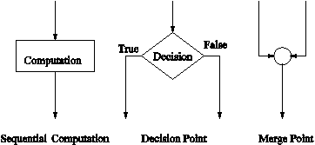
Symbols in CFG

Slide 7
public class VoteEligiblityAge{
public static void main(String []args){
int n=45;
if(n>=18)
{
System.out.println("You are eligible for voting");
} else
{
System.out.println("You are not eligible for voting");
}
}
}

Slide 8
Diagram - control flow graph

Slide 9
Statement Coverage
Execution of all executable statements in the source code at least once.
Calculate the no. of statements in the source code which can be executed given the requirements.
It is used to derive scenario based upon the structure of the code under test.

Slide 10
Scenario to calculate Statement Coverage
Source Code:
Prints(int a, int b){
int result=a+b;
if(result>0)
print(“Positive”,result)
else
print(“Negative”,result)
}

Slide 11
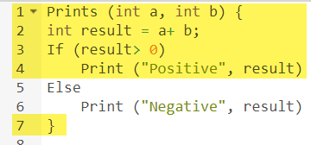
Scenario 1
If a=3, b=9

Slide 12

Scenario 1 (cont.)
Number of executed statements=5
Total no. of statements=7
Statement Coverage: 5/7 = 71%

Slide 13
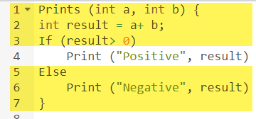
Scenario 2
If a=-3, b=-9

Slide 14

Scenario 2 (cont.)
Number of executed statements=6
Total no. of statements=7
Statement Coverage: 6/7 = 85%

Slide 15

Conclusion
But overall, all the statements are being covered by 2nd scenario's considered. So we can conclude that overall statement coverage is 100%.

Slide 16
Statement Coverage
What is covered by Statement Coverage?
Unused Statements
Dead Code
Unused Branches

Slide 17

Decision Coverage
Reports the true or false outcomes of each Boolean expression
Expressions can sometimes get complicated. Therefore, it is very hard to achieve 100% coverage.

Slide 18
Example
Source Code:
Demo(int a){
if(a > 5)
a=a*3
print(a)
}

Slide 19
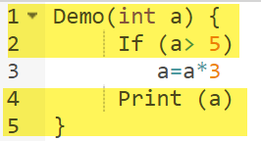
Scenario 1
If a=2

Slide 20
Scenario 1 (cont.)
No. of Decision outcomes exercised = 1 (No)
Total no. of decision outcomes= 2 (Yes/No)
Decision Coverage = 1/2= 50%

Slide 21
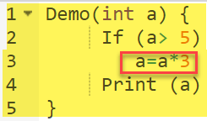
Scenario 2
If a = 6
Decision Coverage = 50%

Slide 22
Decision Coverage
Test Case | Value of a | Output | Decision Coverage
1 | 2 | 2 | 50%
2 | 6 | 18 | 50%

Slide 23

Condition Coverage
How the variables or sub-expressions in the conditional statement are evaluated.
Expressions with logical operands are only considered

Slide 24
Condition Coverage Example
Four Possible Combinations:
TT
FF
TF
FT

Slide 25
Condition Coverage Scenarios
X=3 Y=4 | (x<y) | TRUE | Condition Coverage is ¼= 25%
A=3 B=4 | (a>b) | FALSE
Conditional coverage offers better sensitivity to the control flow than decision coverage.
Condition coverage does not give a guarantee about full decision coverage

Slide 26

Branch Coverage
Every outcome from a code module is tested
If the outcomes are binary, you need to test both True and False outcomes.
Ensure that every possible branch from each decision condition is executed at least a single time.
It measure the fraction of independent code segments.

Slide 27
Example
Source Code:
Demo(int a){
if(a > 5)
a=a*3
print(a)
}

Slide 28
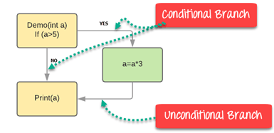

Slide 29
Branch Coverage
Branch Coverage will consider unconditional branch as well
Test Case | Value of a | Output | Decision Coverage | Branch Coverage
1 | 2 | 2 | 50% | 33%
2 | 6 | 18 | 50% | 67%

Slide 30
Branch Coverage Advantages
Allows you to validate-all the branches in the code
Helps you to ensure that no branched lead to any abnormality of the program's operation
Branch coverage method removes issues which happen because of statement coverage testing
Allows you to find those areas which are not tested by other testing methods
It allows you to find a quantitative measure of code coverage

Slide 31
MC/DC Coverage Modified Condition/Decision Coverage
Every condition in a decision must be tested independently to reach full coverage.
Each condition must be executed twice, with the results true and false, but with no difference in the truth values of all other conditions in the decision.
It needs to be shown that each condition independently affects the decision.
With this metric, some combinations of condition results turn out to be redundant and are not counted in the coverage result.
The coverage of a program is then number of executed statement blocks and non-redundant combinations of condition results divided by the number of statement blocks and required condition result combinations.

Slide 32
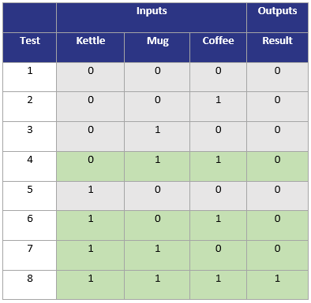
Example
if(kettle && cup && coffee){
return cup_of_coffee;
}
else{
return false;
}
Notes:
Tests 4 & 8 demonstrate that ‘kettle’ can independently affect the outcome. Tests 6 & 8 demonstrate that ‘mug’ can independently affect the outcome. Tests 7 & 8 demonstrate that ‘coffee’ can independently affect the outcome.
Please note, decision coverage and statement coverage are also covered in the selected tests.
The tests required for MC/DC analysis in this case are tests 4, 6, 7 & 8. Tests 1, 2, 3 and 5 are not required as we can satisfy the MC/DC criterion without them. These redundant tests need not be included in the coverage report.

Slide 33
Example
Condition Coverage
A = true / B = true / C = true
A = false / B = false / C = false
Decision Coverage
A = true / B = true / C = true ---> "true"
A = false / B = false / C = false ---> "false"
if ( ( A || B ) && C ){
/*some instructions*/
}
else{
/*some instructions*/
}
With these two tests, it is impossible to know which condition
influences the decision's evaluation...

Slide 34
( ( A || B ) && C )
A | B | C | Decision
F | F | T | F
F | T | T | T
F | T | F | F
T | F | T | T

Slide 35
Indeed, in this case:
between the 1 ^{st} and 4 ^{th} test scenarios, only A changed of value, which also made the decision's outcome change its value ("false" in the 1st case, "true" in the 2 ^{nd});
in the same way, between 1 ^{st} and 2 ^{nd}, only B changed of value, which also made the decision's outcome change its value (passing from "false" to "true");
eventually, between 2 ^{nd} and 3 ^{rd}, only C changed of value and decision's outcome's value also changed (passing from "true" to "false").

Slide 36
More Complex Example
( ( ( u == 0 ) || ( x > 5 ) ) && ( ( y<6 ) || ( z == 0 ) ) )
Test Case | (u==0) | ( x > 5 ) | ( y < 6 ) | ( z== 0 ) | Decision
1 | F | F | F | F | F
2 | F | F | F | T | F
3 | F | F | T | - | F
4 | F | T | F | F | F
5 | F | T | F | T | T
6 | F | T | T | - | T
7 | T | - | F | F | F
8 | T | - | F | T | T
9 | T | - | T | - | T

Slide 37
Path Testing
Structural testing method that involves using the source code of a program in order to find every possible executable path.
It helps to determine all faults lying within a piece of code.
This method is designed to execute all or selected path through a computer program.

Slide 38
Basis Path Testing
Defines test cases based on the flows or logical path that can be taken through the program.
Execution of all possible blocks in a program and achieves maximum path coverage with the least number of test cases.
It is a hybrid of branch testing and path testing methods.
Objective: It defines the number of independent paths, thus the number of test cases needed can be defined explicitly (maximizes the coverage of each test case).

Slide 39
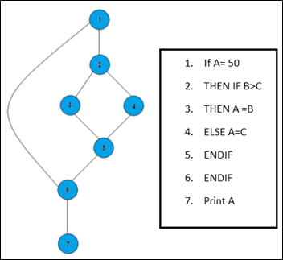
Three paths:
Path 1: 1,2,3,5,6, 7
Path 2: 1,2,4,5,6, 7
Path 3: 1, 6, 7

Slide 40
Steps for Basis Path Testing
Draw a control graph (to determine different program paths)
Calculate Cyclomatic complexity (metrics to determine the number of independent paths)
Find a basis set of paths
Generate test cases to exercise each path

Slide 41
Advantages
It helps to reduce the redundant tests
It focuses attention on program logic
It helps facilitates analytical versus arbitrary case design
Test cases which exercise basis set will execute every statement in a program at least once

Slide 42
McCabe’s Cyclomatic Complexity
It’s a software metric used to measure the complexity of a program.
These metric, measures independent paths through program source code.
Independent path is defined as a path that has at least one edge which has not been traversed before in any other paths.
Cyclomatic complexity can be calculated with respect to functions, modules, methods or classes within a program.
This metric was developed by Thomas J. McCabe in 1976 and it is based on a control flow representation of the program. Control flow depicts a program as a graph which consists of Nodes and Edges.

Slide 43
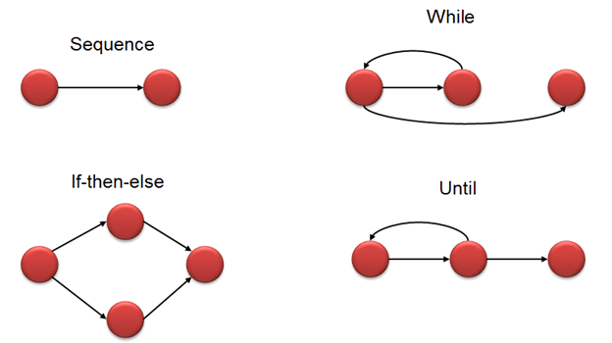
Notations

Slide 44
How to calculate?
V(G) = E - N + 2
E -> No. of Edges
N -> No. od Nodes
V(G) = P + 1
P -> No. of Predicate node (node that contains condition)

Slide 45
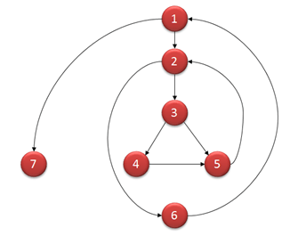
Example
V(G) = 9 - 7 + 2 = 4
V(G) = 3 + 1 = 4 (Condition nodes are 1,2 and 3 nodes)
Basis Set - A set of possible execution path of a program
1, 7
1, 2, 6, 1, 7
1, 2, 3, 4, 5, 2, 6, 1, 7
1, 2, 3, 5, 2, 6, 1, 7

Slide 46
01. insertion_procedure (int a[], int p [], int N)
02. {
03. int i,j,k;
04. for (i=0; i<=N; i++) p[i] = i;
05. for (i=2; i<=N; i++)
06. {
07. k = p[i];
08. j = 1;
09. while (a[p[j-1]] > a[k]) {p[j] = p[j-1]; j--}
10. p[j] = k;
11. }
12. }

Slide 47
01. insertion_procedure (int a[], int p [], int N)
02. {
03. (1) Int i,j,k;
04. (2) for ((2a)i=0; (2b)i<=N; (2c)i++)
05. (3) p[i] = i;
06. (4) for ((4a)i=2; (4b)i<=N; (4c)i++)
07. {
08. (5) k=p[i];j=1;
09. (6) while (a[p[j-1]] > a[k]) {
10. (7) p[j] = p[j-1];
11. (8) j--
12. }
13. (9) p[j] = k;
14. }

Slide 48
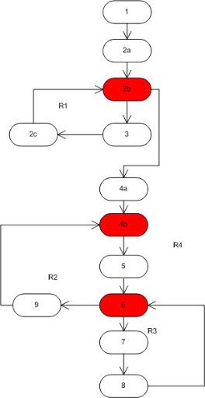
No. of Predicates = 3
So, V(G)= P+1 = 4
No. of Edges = 14,
No. of Nodes = 12
So, V(G) =E-N+2
= 14 – 12 + 2 = 4
As complexity has calculated as 4, four test cases are necessary to the complete path coverage for the above example.

Slide 49
Properties of CC
V (G) is the maximum number of independent paths in the graph
V (G) >=1
G will have one path if V (G) = 1
Minimize complexity to 10

Slide 50
More on V(G)
Cyclomatic complexity can be calculated manually if the program is small.
Automated tools need to be used if the program is very complex as this involves more flow graphs.
Based on complexity number, team can conclude on the actions that need to be taken for measure.

Slide 51
Complexity Number | Meaning
1-10 | Structured and well written code High Testability Cost and Effort is less
10-20 | Complex Code Medium Testability Cost and effort is Medium
20-40 | Very complex Code Low Testability Cost and Effort are high
>40 | Not at all testable Very high Cost and Effort

Slide 52
Calculate CC..
i = 0
n = 4; //n- no. of nodes present in graph
while ( i < n – 1 ){
j = i + 1;
while ( j < n ){
if( A[i] < A[j] )
swap ( A[i], A[j] );
}
i=i+1;
}

Slide 53
Assignment
Consider the code in slide no. 2 and calculate all code coverage criteria. Also make CFG of that program and calculate the complexity of that unit of code.

